Slide 1
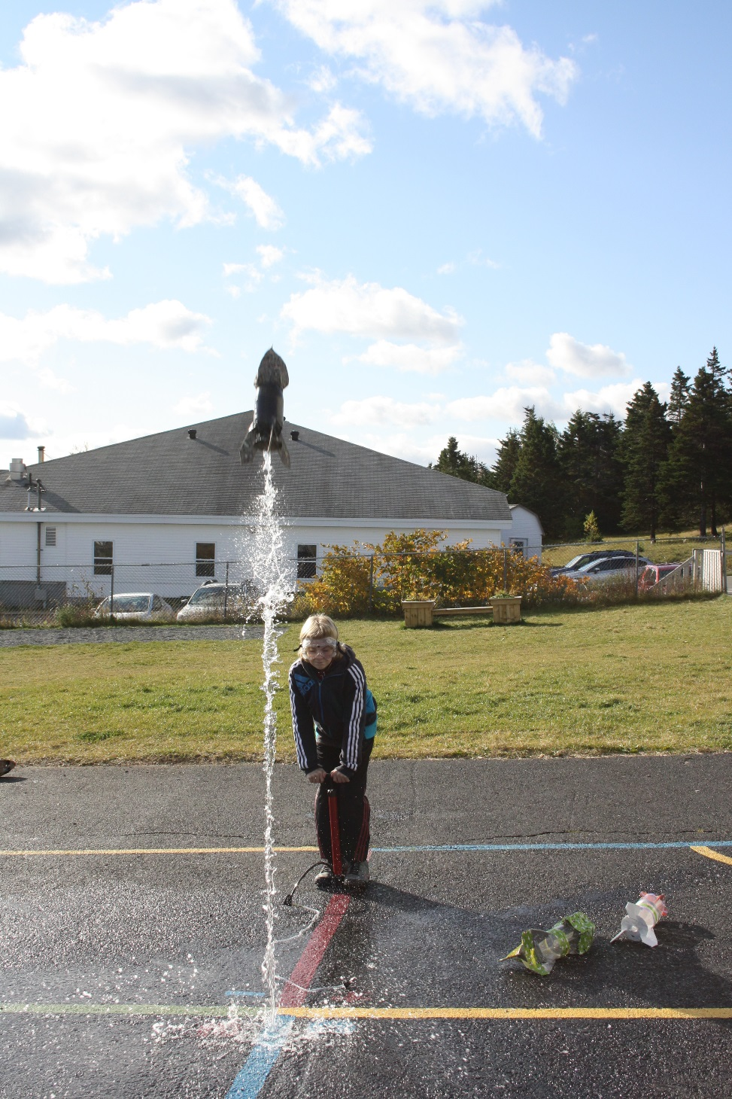
The Amazing
Water Rocket

Slide 2
Purpose
To build a water rocket and see if I can propel it into the air using water and air.

Slide 3
Materials
Corrugated cardboard
2 litre pop bottle
Tuck tape
Water
Bicycle air pump
Hose with rubber stopper

Slide 4
Procedure
Cut out all paper parts of the rocket design.
Trace the design onto corrugated cardboard.
Cut out all cardboard parts.
Tape all parts onto the 2 litre bottle.
Add 500 mL of water to your rocket.
Insert rubber stopper and hose.
Pump air into the rocket until lift-off.

Slide 5
Hypothesis
I think that the rocket will lift-off after 5 pumps of air.

Slide 6
Observations
After one pump of air, when I squeezed the bottle, it was harder to squeeze.
There were bubbles near the cap of the bottle as I pumped.
After 7 pumps of air, the rubber stopper was forced out of the bottle and the rocket shot upward.
The rocket went as high as the roof of our school.

Slide 7
Conclusion
After 7 pumps of air, my water rocket was propelled into the air reaching a height equal to the height our school’s roof.

Slide 8
The Science Behind It
As air is pumped into the plastic bottle, the air pressure inside the rocket increases. This air is pushing on the plastic of the bottle and on the rubber stopper. When the pressure gets strong enough, it forces the rubber stopper and the water out of the bottle. This in turn creates thrust for the rocket to move upward.

